Slide 1

Bengali.AI Handwritten Grapheme Classification
Problem Statement:
Given the image of a handwritten Bengali grapheme, challenge is to separately classify three constituent elements in the image grapheme root, vowel diacritics and consonant diacritics.

Slide 2
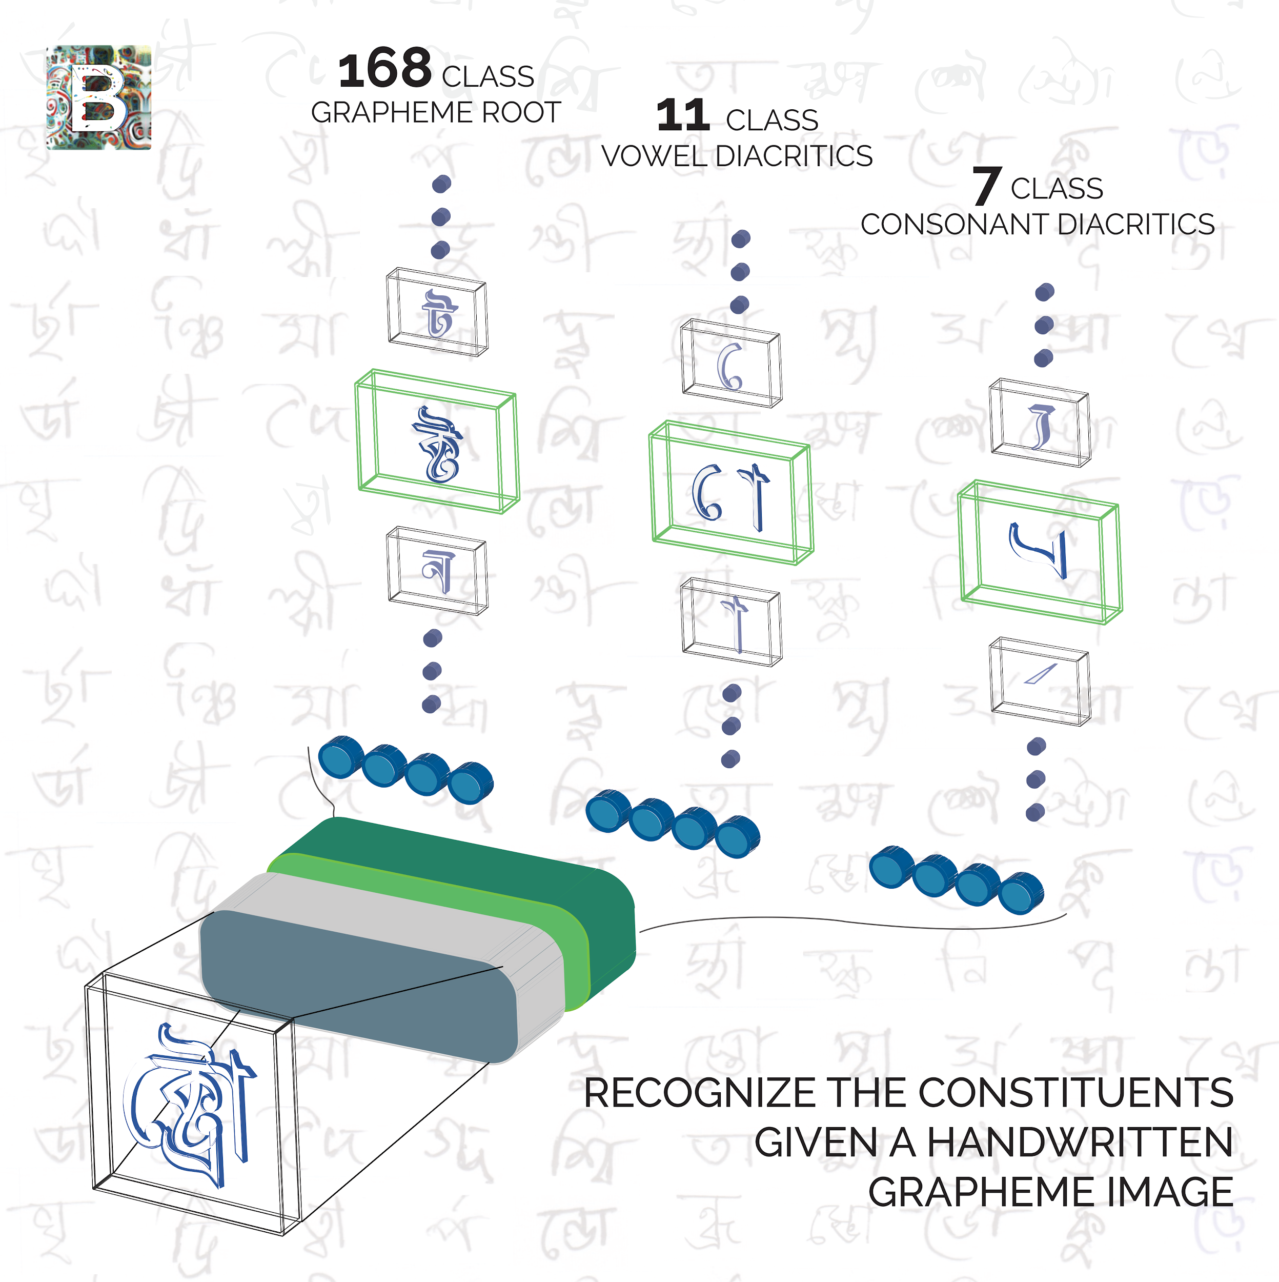
Insight into Training Data
Each Bengali character consists of 3 components ( 3 output variables )
Component | No. of Classes of each variable
Grapheme_root | 168
Vowel_diacritic | 11
Consonant_diacritic | 7

Slide 3
Solution Approach
Data preprocessing
Model applied: Convolutional Neural Network
Modifying various layers in CNN
Optimizing parameters and hyperparameters
Training the model
Validating the model
Testing the model

Slide 4
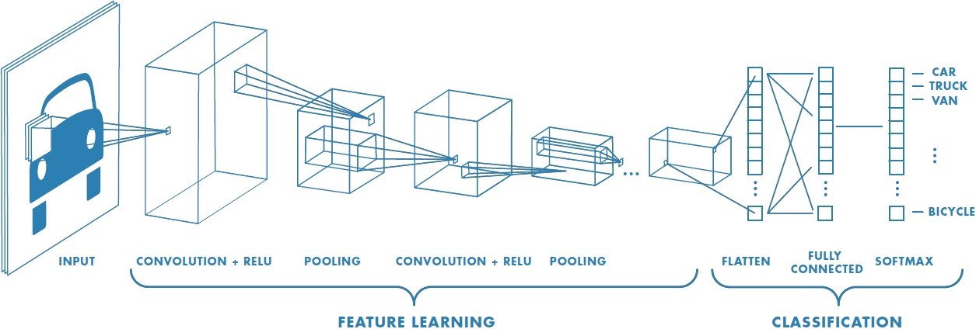
Architecture of Model Used
CNN (Convolutional Neural Networks)
Class of deep Neural Networks
Building block of CNN: A mathematical operation, Convolution
Inspired by biological processes
Require little pre-processing compared to other Image classification problems
Consists of Input layer, hidden layers & output layer

Slide 5
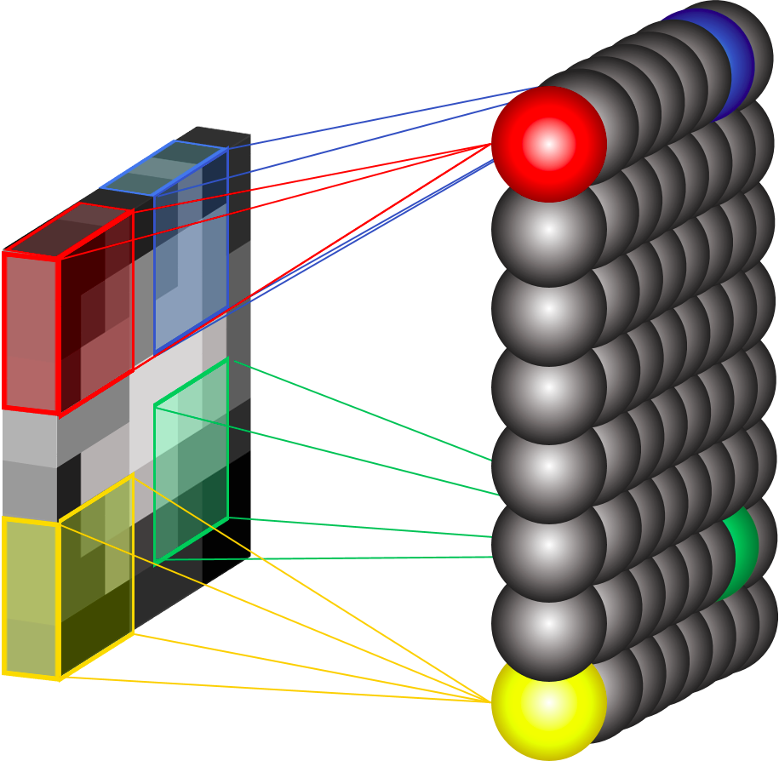
Why to use CNN ??
Adaptive image processing
Automatically detects the important features without any human supervision.
Computationally efficient.
Performs parameter sharing
Can easily run on any device
CNN is better than NN because:
Uses concept that two pixels that are nearer to each other are more likely to be related than the two pixels that are apart from each other
No need to link all nodes.
Reduces load as compared to NN.

Slide 6

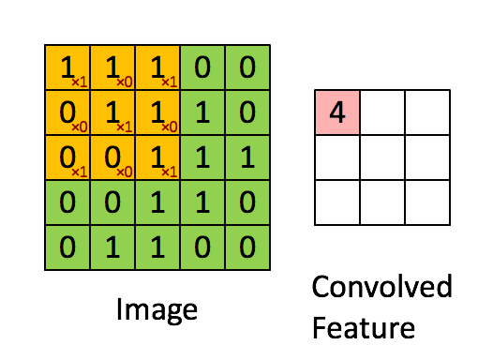
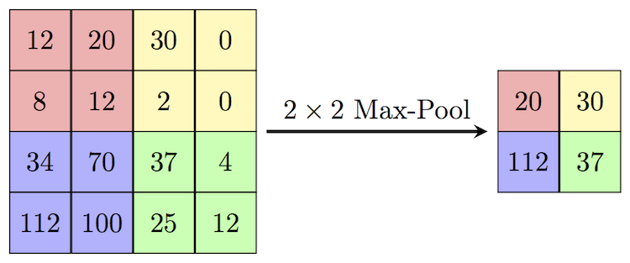
Layers applied to Model
Dropout Layer
Convolutional Layer
Max Pooling Layer
Core building block of CNN
Parameters: Filters or Kernels
Convolution (Dot product) b/w Filter and input (same shape)
Reduce dimensions of layer
Reduces parameters and computation
Control overfitting
Compute Maximum element from a cluster of neurons
Nodes dropped out with some probability
Prevent overfitting

Slide 7
Computed Accuracy & Loss
ACCURACY | Grapheme_root | Vowel_diacritic | Consonant_diacritic
Training Data | 87.49 % | 96.80 % | 97.18 %
Validation Data | 87.68% | 96.37 % | 96.87%
LOSS | Grapheme_root | Vowel_diacritic | Consonant_diacritic
Training Data | 0.8861 | 0.1052 | 0.0872
Validation Data | 0.4447 | 0.1113 | 0.1056

Slide 8
SWOT Analysis
Strength
Good Accuracy
Weakness
Threats
Good number of competitors
Oppor-tunities
Cost effective
Easy implementation practically
Letter can be predicted irrespective of its position in data.
Large training data required
Comparatively lower accuracy in grapheme_root prediction
Low resolution images may get poor accuracy
Bengali - 5th most spoken language in world
Demands good OCR algorithms
Business and Educational opportunities

